Slide 1

Power BI Visualization Of Covid-19
YEAR- 2020,21,22

Slide 2

Contents
Overall Covid growth in whole world
Covid growth by year (2020,21,22)
Covid analysis of India.

Slide 3
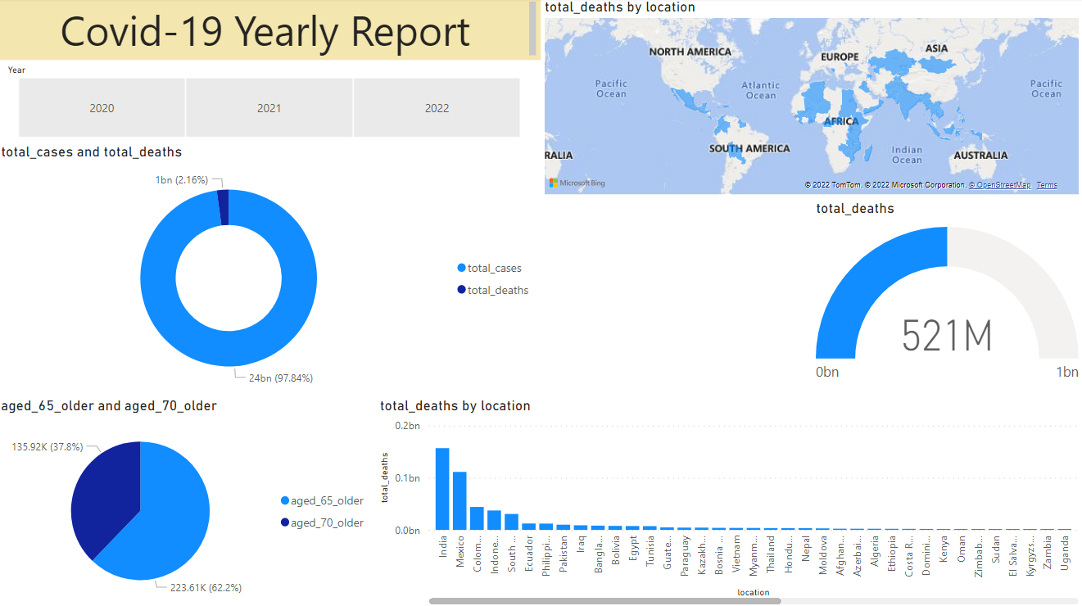
Overall Covid-19 impact (2020,21,22)

Slide 4
Total deaths by location
Impact of Covid-19 can be seen where we can analyze India was hit by a very huge number in deaths.

Slide 5
Total deaths Globally
Total deaths across globe were around 521 Million in 2020,21,22 .

Slide 6
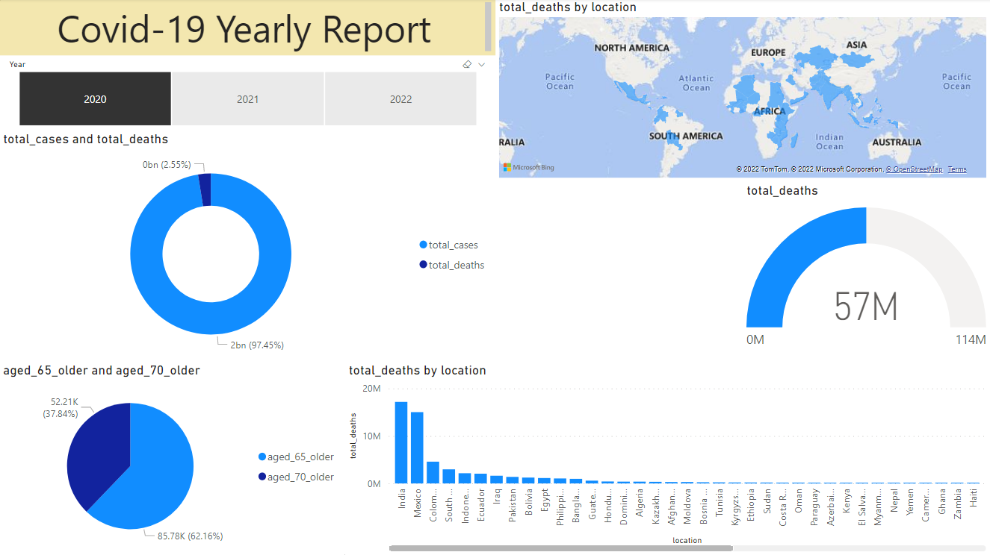
Covid-19 report of year 2020
In year 2020, total deaths were around 57 million, while total positive cases found were approx. 2 billion.
In this we can also analyze that death rate was highest in India (approx.17 mil.) and second to that was Mexico.

Slide 7
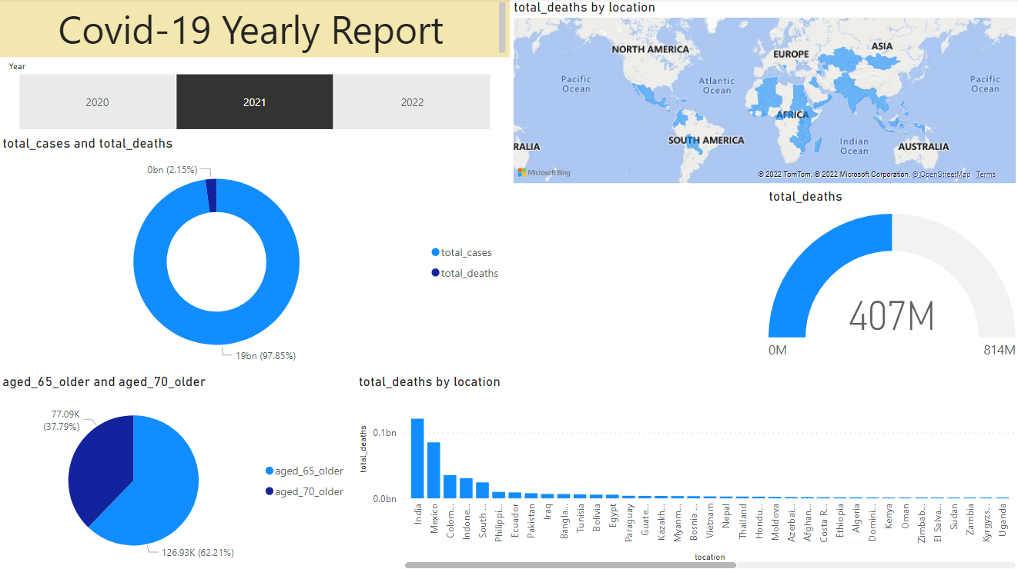
Covid-19 report of year 2021
Year 2021 saw a big jump in no. of deaths (407 Million) and 19 billion cases.
This year India saw devastating death rate of around 120 million.

Slide 8
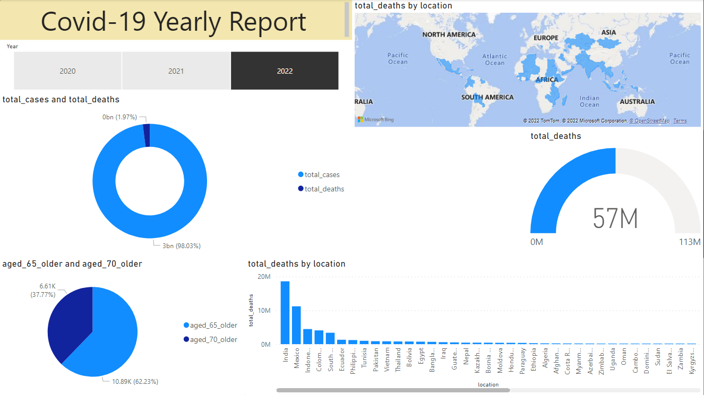
Covid-19 report of year 2022
In 2022, the covid deaths and cases became less as the vaccine was introduced (57 Million deaths till this data).
This is a good number comparing with last year( approx. 350 million less deaths).

Slide 9
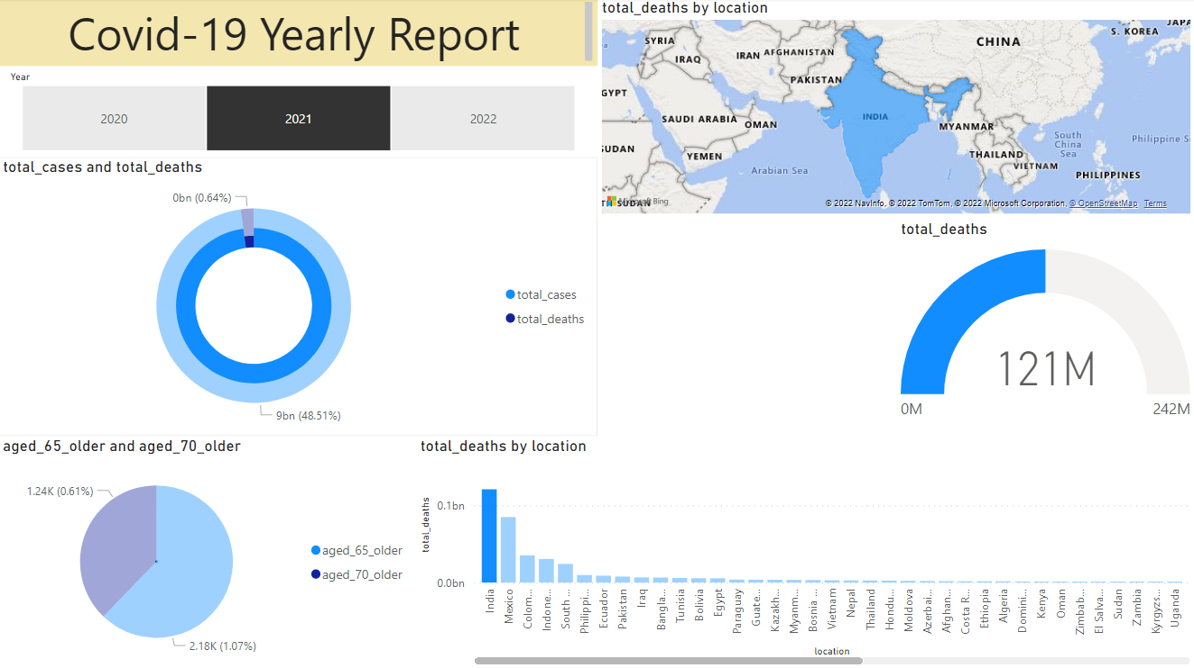
Covid-19 report of year 2021(India)
In India, all states were affected by covid-19.
Around 48% were the total cases in India comparing from rest of the world.

